Slide 1
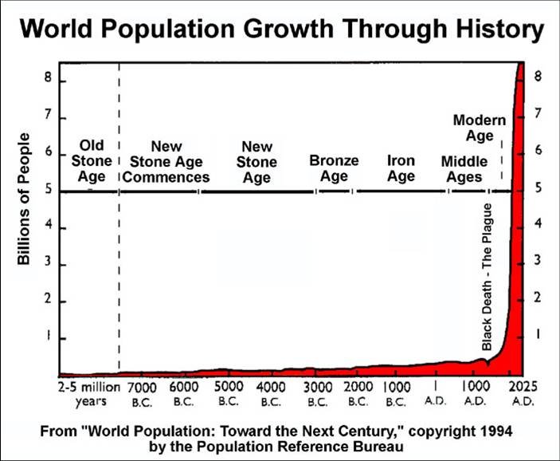

Slide 2
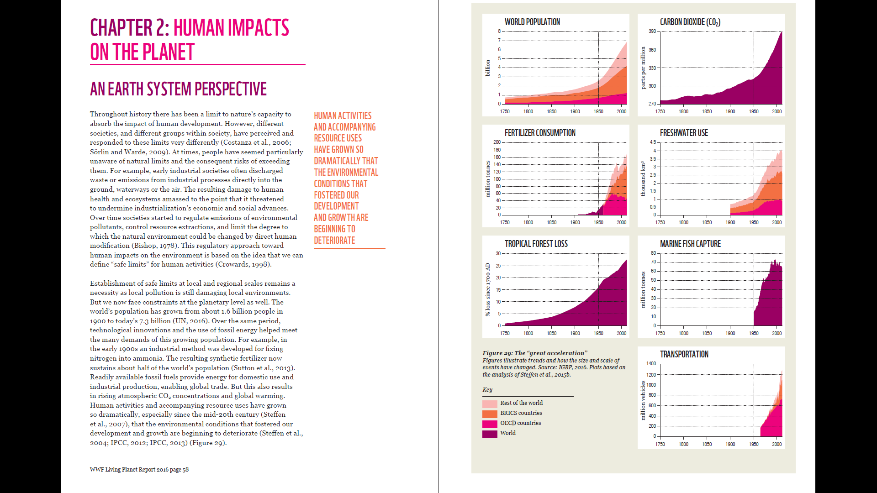
Living Planet Report 2016
(https://www.worldwildlife.org/pages/living-planet-report-2016)

Slide 3
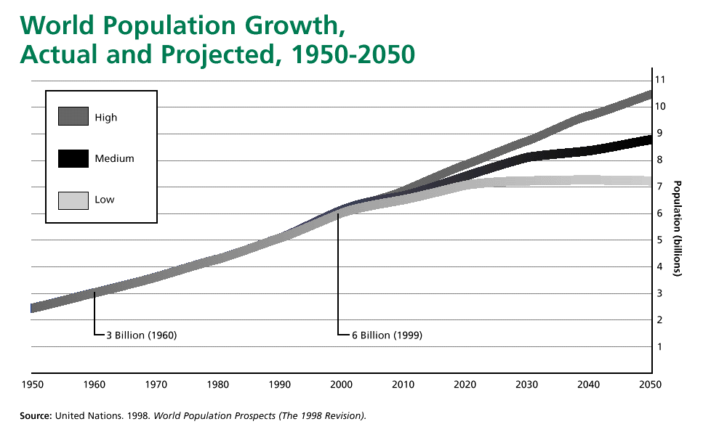
http://www.worldometers.info/world-population/

Slide 4
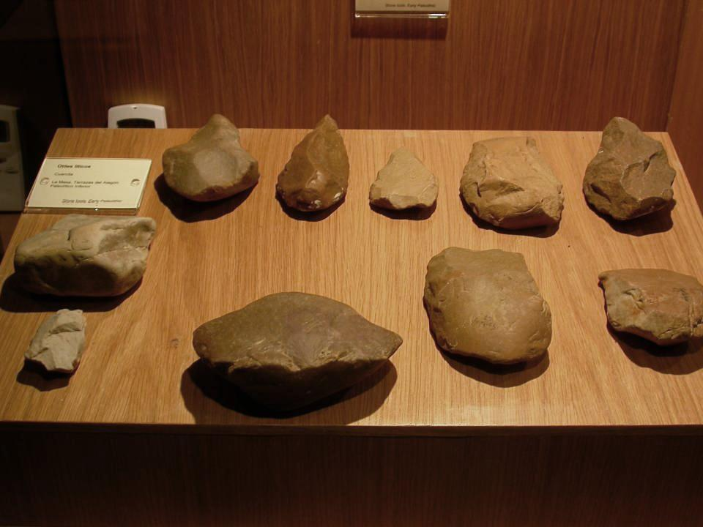

Slide 5
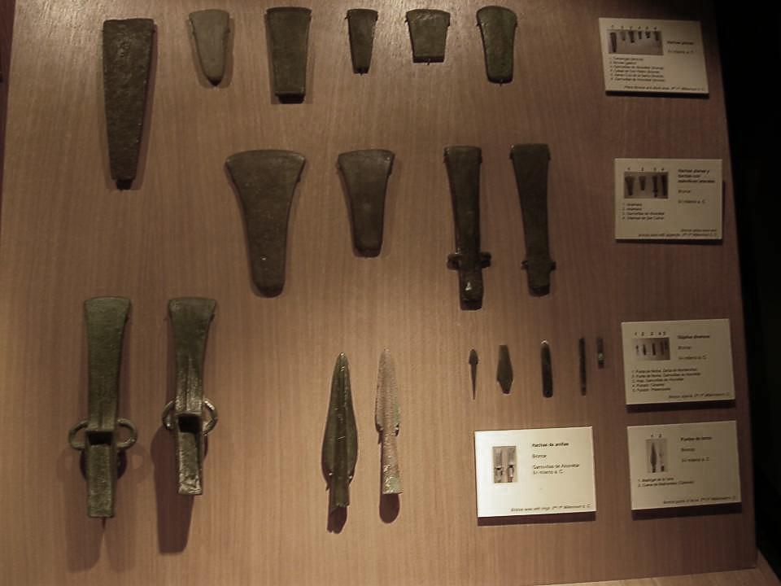

Slide 6
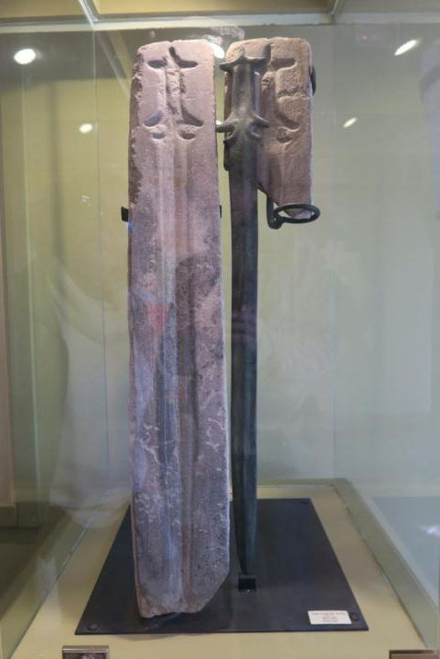

Slide 7
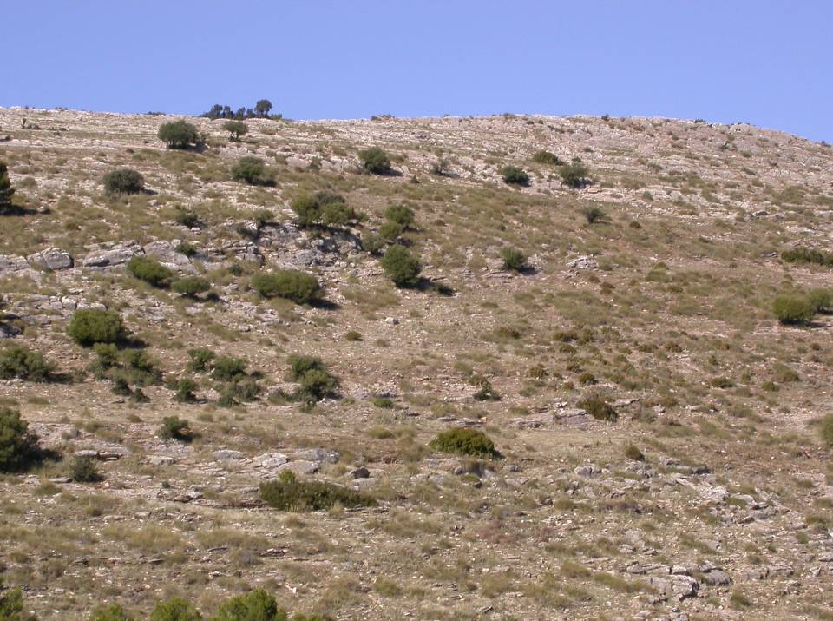
Abandoned lands!

Slide 8
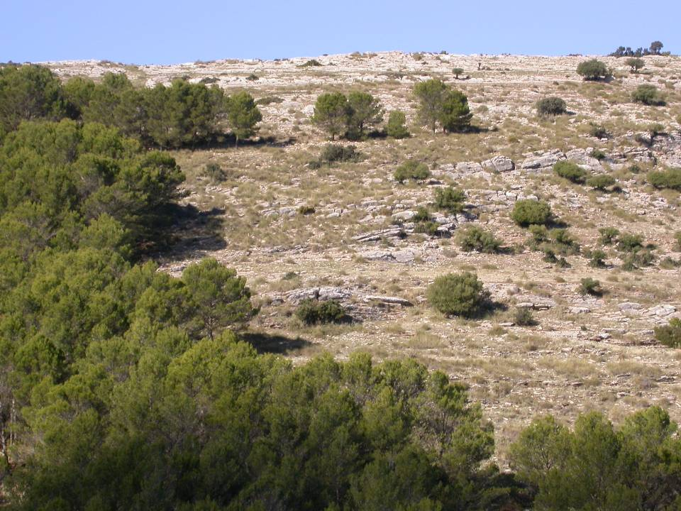
But they are able to stand forests!

Slide 9
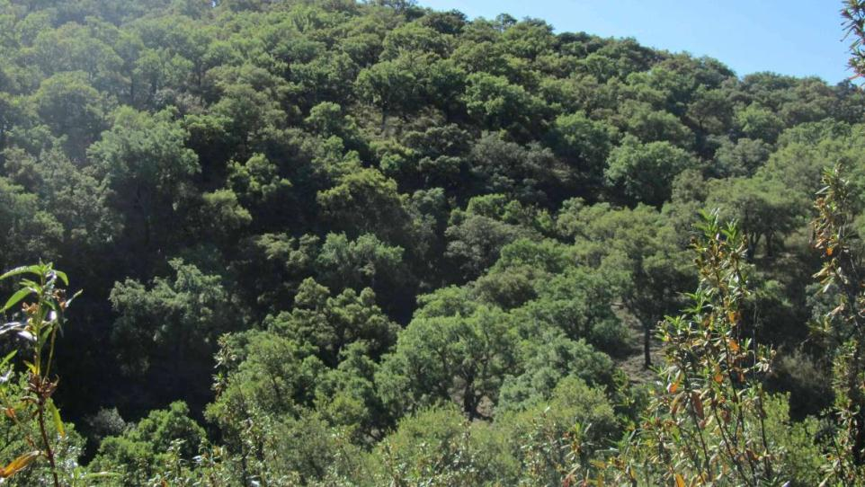
Climacic vegetation. Example: Cork oak in Sierra Morena mountain range.

Slide 10
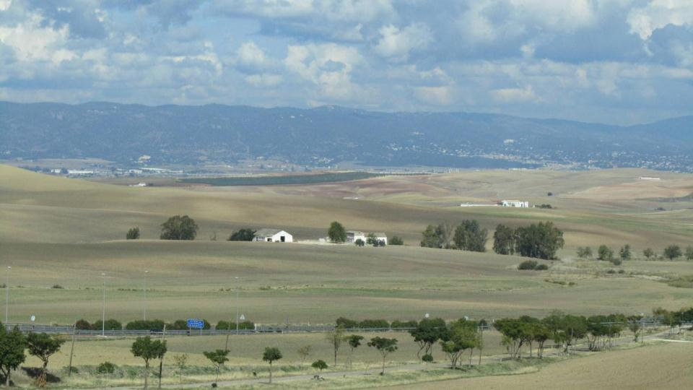
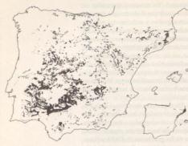
Valle del Guadalquivir (Guadalquivir meadow)
Ancient deforestation

